Slide 1
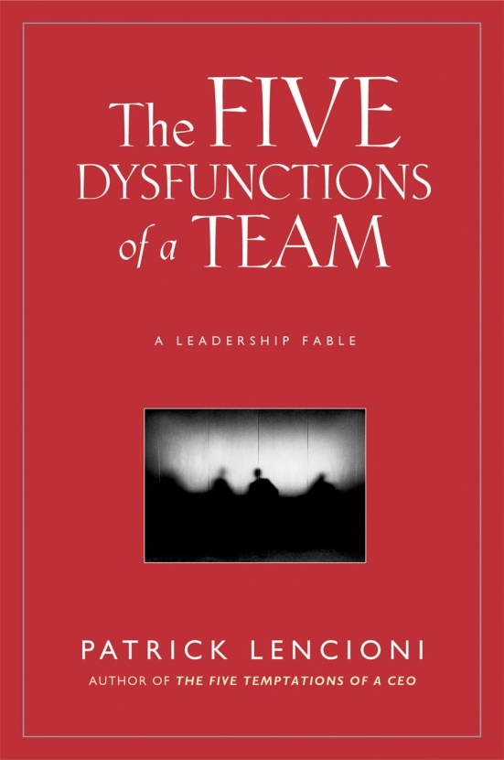
The Five Dysfunctions of A Team Written By: Patrick Lencioni
Presented By:
Nate Bauman
Jenn Dreier
Debbie Meagher
Ryan Schmitt

Slide 2
About the Author
Patrick Lencioni is the author of 8 best-selling books with over 2.5 million copies sold.
Recognized in Fortune Magazine as “A Top Ten Guru You Should Know.”
Is the founder and president of The Table Group which is a company dedicated to providing organizations with ideas, products and services that improve teamwork and employee engagement.
Notes:
His work has been in The Wall Street Journal, USA Today, & Harvard Business Review.

Slide 3
About the Author
His clients include Fortune 500 companies, professional sports organizations, the military, non-profit groups, schools, and churches.
Prior to founding The Table Group, Lencioni worked as a corporate executive for Skybase, Oracle, and Bain Company.
Was on the board for the Make-A-Wish Foundation.

Slide 4
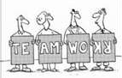
The Five Dysfunctions of A Team
Why did Patrick Lencioni choose to write this book?
Wants to describe how a healthy team interacts and what it feels like to be part of a successful team.
Outlines steps that can be used by a team to overcome common hurdles and to build a cohesive, effective team.
Wants to teach teams how to overcome a
lack of trust among team members.
Shows ways to help a team engage in constructive conflict.
Describes how to follow a clear, concise, and practical guide to using the Five Dysfunctions Model to improve teams.
How to achieve the real power of teamwork.

Slide 5
The Five Dysfunctions of A Team Synopsis:
Written as a “leadership fable.”
Tells the story of a Silicon Valley technology company that is having trouble finding new customers.
New CEO (Kathryn) is brought in to teach other executives how to work together as a team.
CEO realizes that the company has innovative products and great talent but they are hindered by a working as a dysfunctional team.
Team dynamics have eroded, no one is accepting responsibility, deadlines are being missed and employee moral is on the decline.
As a result, the company is losing the battle for market share.
Following the “leadership fable” is an analysis of the five dysfunctions of a team which eventually leads to a cohesive team.

Slide 6
The Five Team Dysfunctions:

Slide 7
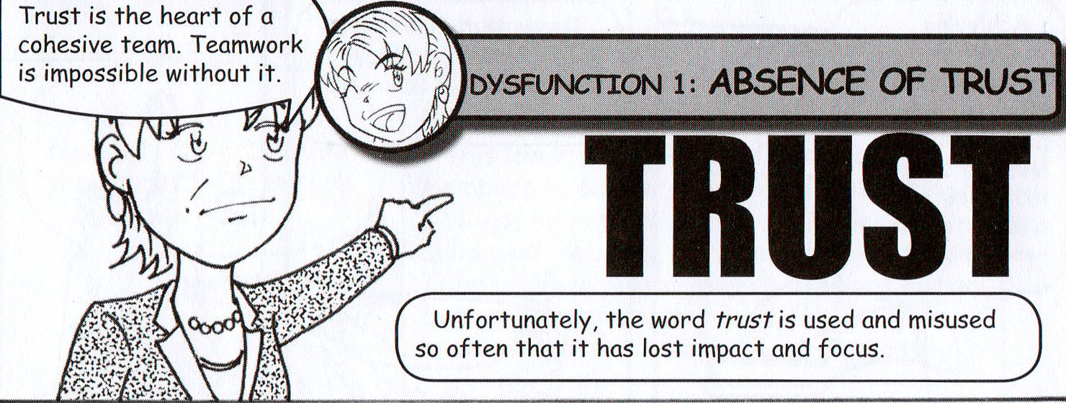
Dysfunction 1
Lack of Trust Video Clip
The Informant!
http-//www.imdb.com/vide#333E35

Slide 8
Dysfunction 1:
Occurs when team members are reluctant to be vulnerable with each other and are unwilling to admit their mistakes, weaknesses, or need for help.
Suspect the worst of each other, hold grudges, fail to recognize and tap into each other’s skills and experiences, and find reasons to avoid spending time with each other.
Morale on distrusting teams is usually low, and unwanted turnover is high.

Slide 9
How to Overcome Dysfunction 1: Absence of Trust
The key to overcoming a lack of trust is through shared experiences, multiple follow-throughs, and integrity.
Team can complete personal histories exercises, team effectiveness exercises, personality and behavioral preference profiles, 360-degree feedback, and experiential team exercises.
Leader must demonstrate vulnerability, risk a loss of face in front of the team and encourage subordinates to do the same.
Notes:
Personal Histories Exercise – requires team members to answer questions about their siblings, hometown, unique challenges in childhood, hobbies, first job, and worst job. Helps to relate to each other as human beings with interesting lives, breaks down barriers, and encourages greater empathy.
Team Effectiveness Exercise – team members speak about the most important contribution each of their peers makes, and one behavior that should be altered or eliminated. Involves more risk but can potentially obtain constructive information.
Personality and Behavioral Preference Profiles- most effective for building trust and produce practical and scientifically valid behavioral descriptions of how people think, speak, and act.
360-degree Feedback – call for peers to judge each other openly. Identifies strengths and weaknesses.

Slide 10
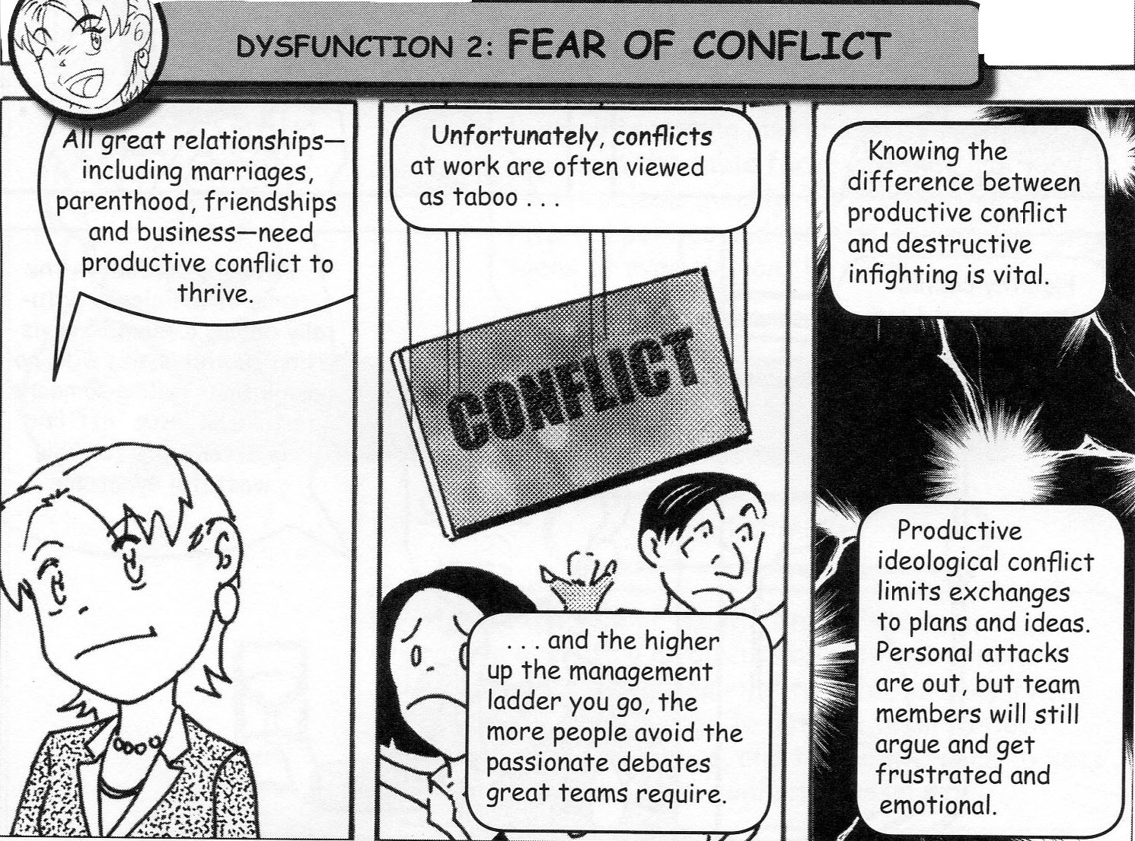
Dysfunction 2
Fear of Conflict Video Clip
Office Space
http-//www.youtube.com/w#333EC0

Slide 11
Dysfunction 2:
All great relationships need productive conflict to thrive.
Teams that lack trust are incapable of engaging in unfiltered, passionate debate about key issues.
Teams that fear conflict waste lots of time and energy, ignore controversial topics critical to success, and fail to tap into the perspectives of all team members.

Slide 12
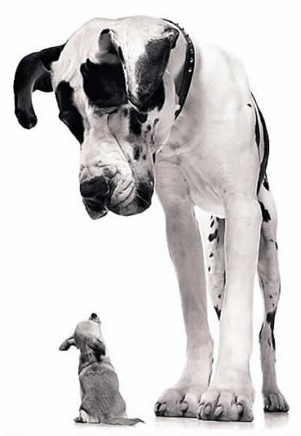
How to Overcome Dysfunction 2: Fear of Conflict
Leaders and team members need to coach each other and encourage debate.
Lead by example!
Utilize the Thomas-Kilmann Conflict Mode Instrument; allows people to approach conflict strategically.
Leaders need to allow the team to sort situations out themselves, even when things get loud and messy.
Leaders also need to force clarity and closure.
Conflict mining – brings buried disagreements to light; objectivity is needed as well as the courage to work through sensitive issues, and the persistence to keep things moving until the conflict is resolved.
Never Fear Conflict

Slide 13
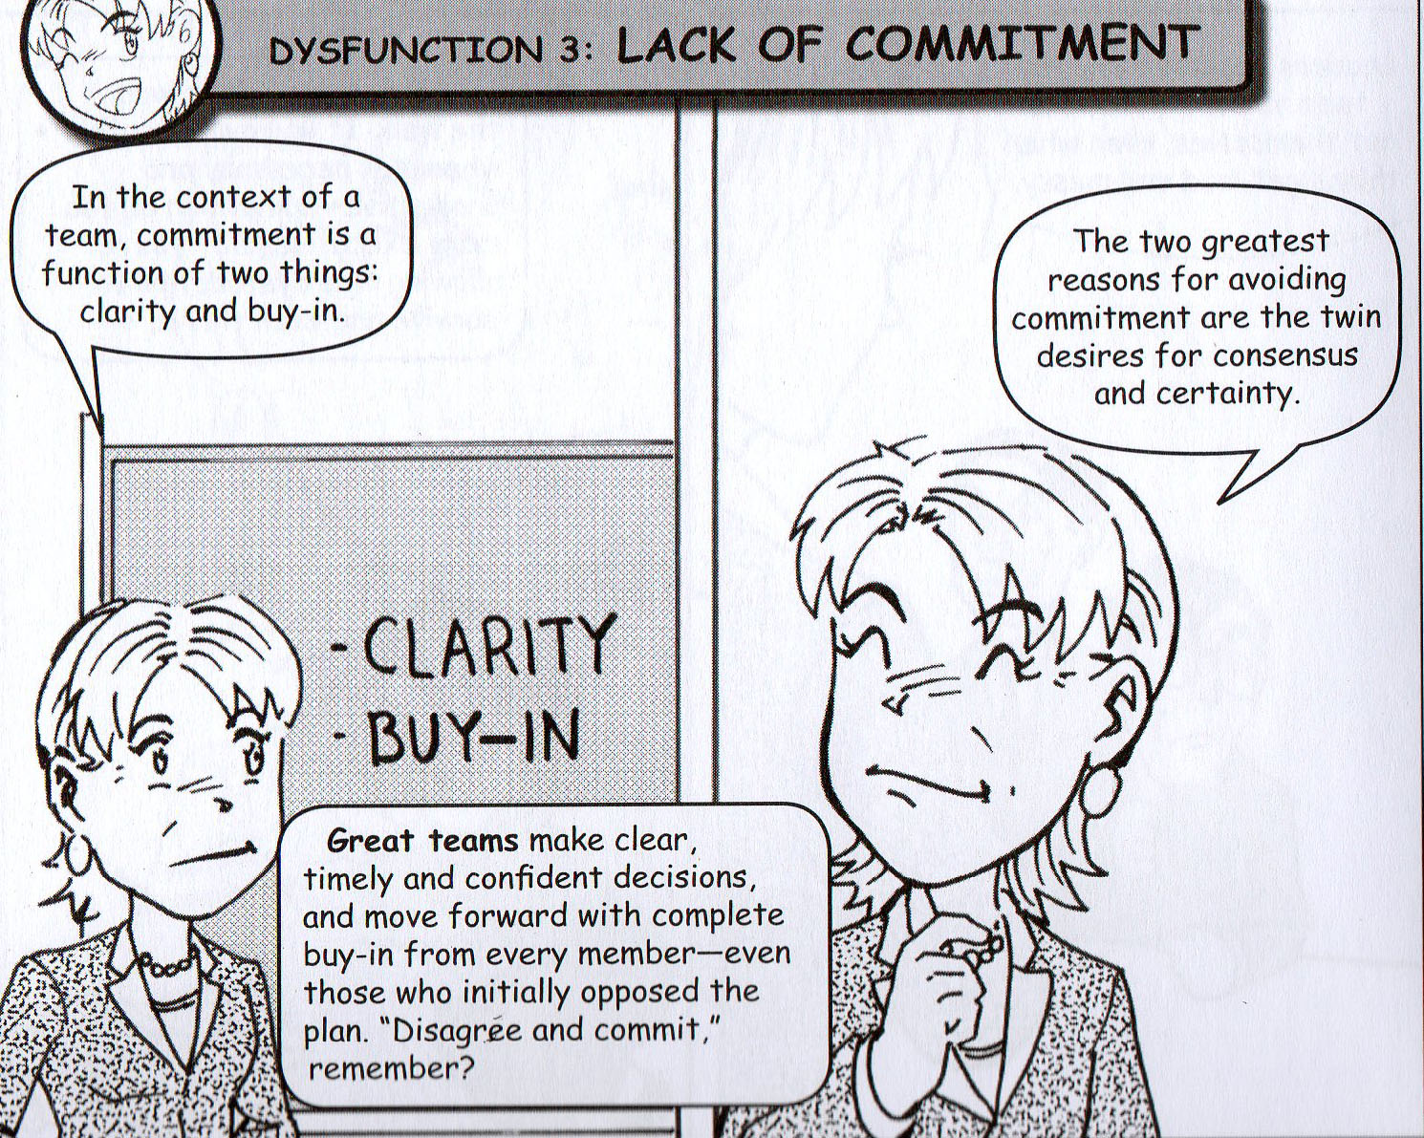
Dysfunction 3
Lack of Commitment
Video Clip
Office Space
http-//www.youtube.com/w#33449C

Slide 14
Dysfunction 3:
Commitment is a function of clarity and buy-in.
A lack of commitment arises from not hearing all the of teams concerns before making a decision.
A team that fails to commit loses direction and lacks priorities.
Teams over-analyze and delay decisions.
Destroys confidence, inspires a fear of failure, and sets up a culture of second-guessing the moves they make and who makes them.

Slide 15
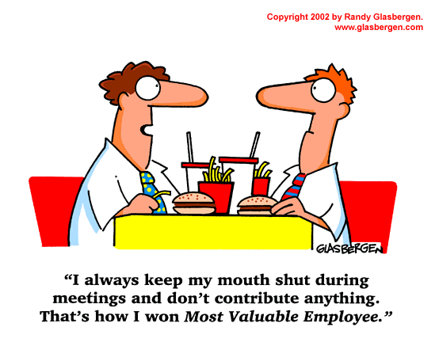
How to Overcome Dysfunction 3: Lack of Commitment
Align around common objectives and makes team direction and priorities clear.
Maximize clarity, ensure buy-in, and resisting the lures of consensus and certainty.
Cascading Messages – team reviews key decisions made at a meeting and agree on what information employees and other stakeholders need.
Leaders can help facilitate commitment by reviewing all key decisions made at the end of team meetings, making responsibility and deadlines clear.

Slide 16
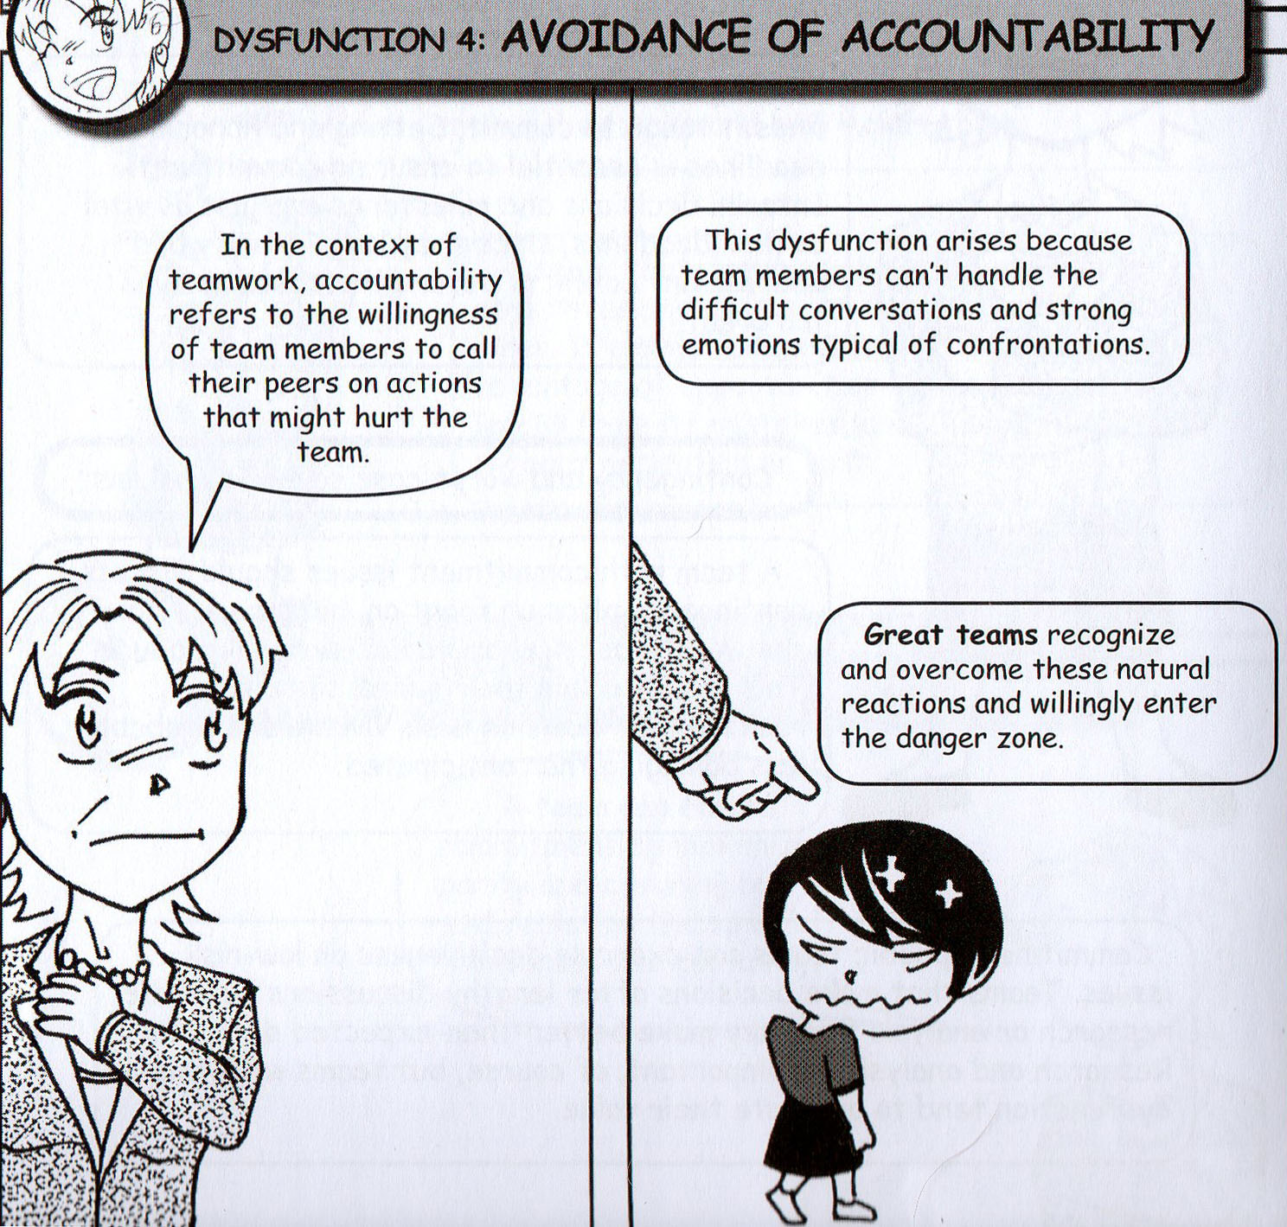
Dysfunction 4
Avoidance of Accountability
Video Clip
The Office
The Office- Employee of #3349CC

Slide 17
Dysfunction 4:
Accountability refers to the willingness of them members to call their peers on actions that might hurt the team.
Team members can’t handle the difficult conversations and strong emotions typical of confrontations.
Teams that avoid accountability encourage mediocrity, miss deadlines, and fail on key deliverables.

Slide 18
How to Overcome Dysfunction 4: Avoidance of Accountability
The leader needs to be clear about what the team needs to achieve, who needs to deliver what, and how everyone should behave.
Team members should communicate constantly about their relative performance against stated objectives and standards.
Shift rewards away from individual performance to team achievement creates accountability.
A strong leader who acts as the only source of discipline also creates accountability within the team.

Slide 19
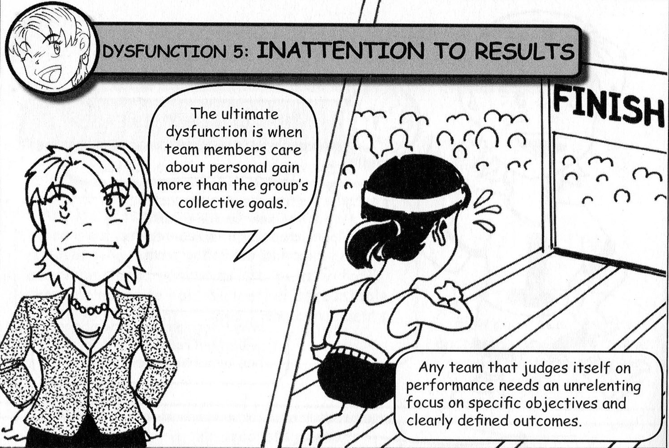
Dysfunction 5
Inattention to Results
Video Clip
The Office
YouTube - The Office But#334C2A

Slide 20
Dysfunction 5:
Ultimate dysfunction is when team members care about personal gain more than the group’s collective goals
A team that doesn’t focus on collective results stagnates, and achievement-oriented employees leave as the company loses its competitive edge.
Team members become distracted as they focus on personal goals.

Slide 21
How to Overcome Dysfunction 5: Inattention to Results
Leaders must focus on collective results.
Leaders must also make goals clear and reward the behaviors and actions that contribute to them.
Tie rewards and compensation to specific outcomes to ensure that team members also focus on collective results.

Slide 22
Breakout Exercise Team Assessment Exercise
What results did you find?

Slide 23
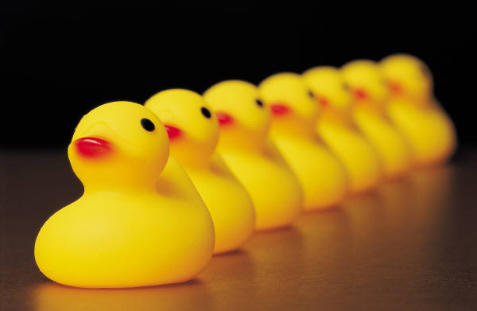
To Sum Things Up
A team leader must be focused, selfless, objective, recognize contributions and achievement of group goals.
Successful teamwork involves following a set of principles over a long period, and embracing common sense with uncommon levels of discipline, persistence, and openness.
Great teams overcome the tendencies that make trust, conflict, commitment, accountability, and a focus on results by acknowledging their imperfections.
Are all of your ducks in a row?

