Slide 1
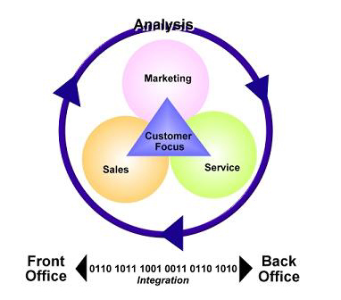
Customer Relationship Management
Allen Zernich
Trever Hoelker
Melissa Holthaus

Slide 2
Presentation Agenda
What is Customer Relationship?
Who uses Customer Relationship Management?
Main purposes of Customer Relationship Management
The Pros and Cons of Customer Relationship Management
Real Life Example
Notes:
What is CRM?
- Provide a definition.
- Overview of its use.
Provide an example of a CRM system used in practice.
2. Who uses CRM?
- Primary users.
- Industries where CRM is most prevalent.
3. Main purposes of CRM
- Factors to consider…
4. The pros and Cons of CRM
- The effect of the benefits to a CRM system.
- The effect of the shortcomings of a CRM system.
5. Real life example
- A shared personal experience of working with a CRM module (Melissa).

Slide 3
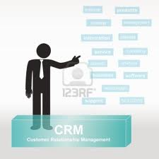
CRM Defined
Customer Relationship Management:
- A model for managing a company’s interactions with current and future customers. It involves using technology to organize, automate, and synchronize sales, marketing, and technical support.
Notes:
Customer Relationship Management:
Phrased another way, CRM integrates the capturing of pertinent information as it relates to a company’s existing or target customer base, learning from that information to adapt business operations to develop new processes, technologies, or products, and ultimately maximizing the return on investment that goes along with the interaction and emphasis on customers.

Slide 4
The Keys to CRM
Identifying and targeting the best customers, managing marketing campaigns and generating quality leads.
Optimizing information shared and streamlining processes.
Formulation of individualized relationships to improve customer satisfaction and maximize profits.
Supplying appropriate information to understand customer needs.
*** Largely accomplished with the aid of CRM software and technology***
Notes:
Keys of CRM:
1. Helping an enterprise to enable its marketing departments to identify and target their best customers, manage marketing campaigns and generate quality leads for the sales team.
2. Assisting the organization to improve account and sales management by optimizing information shared by multiple employees, and streamlining existing processes.
3. Allowing the formation of individualized relationships with customers, with the aim of improving customer satisfaction and maximizing profits; identifying the most profitable customers and providing them the highest level of service.
4. Providing employees with the information and processes necessary to know their customers, understand and identify customer needs and effectively build relationships between the company, its customer base, and distribution partners.
Note: Many organizations turn to CRM software to help them manage their customer relationships.

Slide 5
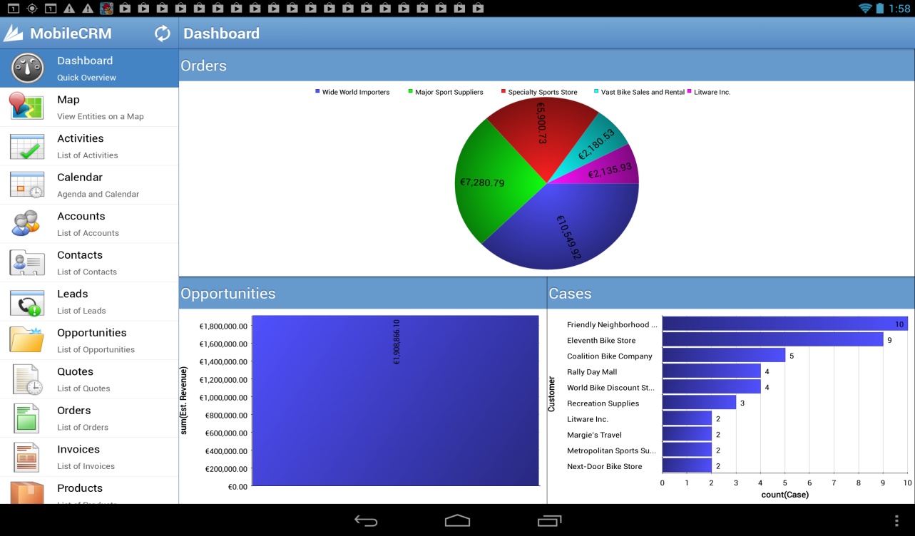
The Use of crm
Visual representation of results to customers.
Data mining and gathering.
E-business strategy creation.
Notes:
A. Visual representations of results to customers.
- Product display and presentation
- Product evaluation and selection
Thorough analysis of customer data
B. Data mining and data gathering
- Coordination of operations that make the organization customer centric.
- Streams of CRM support
Front-end systems
Data management tools
Back-end systems
C. E-business strategy creation.
- Components toward this strategy
Process
Technology
People

Slide 6
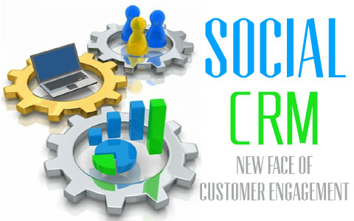
CRM and social media
http://www.youtube.com/watch?v=0VgReYKrYfw
Notes:
With the confluence of business processes and social media dominating at many corporations, CRM is just another area in which companies are utilizing the social media function to expand its reach.
The following video presents a scenario of a how this social strategy is helping to improve customer relationships.

Slide 7
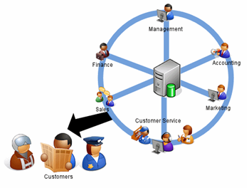
WHO SHOULD USE CRM?
Any business with customers should use CRM!
Companies looking to acquire a more structured process.
Businesses who want to show customers are priority.
Notes:
Any business with customers should use CRM! (Every Business, Everyone)
-Has tremendous upside as previously described by Melissa and the short video.
-CRM helps tie in the sales team with the marketing team with the accounting team and so on and so forth.
-Noted in the video, CRM can issue quotes or invoices to customers and ultimately keep the business more organized.
Businesses who want to show customers are their priority.
-It’s not just about the internal organization that comes about from implementing a CRM system, but it’s also about the customer. As shown in the video, the company chose to hire the painters who seemed more organized and efficient. CRM helps translate its benefits to its customers as well showing that time is money. Furthermore, it helps those businesses who utilize CRM to study and learn more about their target markets’ needs and purchasing behavior. A WIN, WIN situation for both the company and the customer.

Slide 8
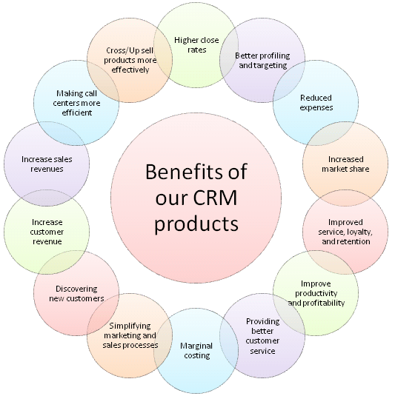
Benefits of CRM
Organization of current and future customers
Cost reduction
Notes:
If you haven’t already recognized some of the high level perks of CRM systems, these next few slides are dedicated to highlighting some of the main purposes of CRM.
1. Organization of current/potential customers
a. Enhance company relationship with customers through personalization
b. Identify/anticipate customers’ needs
2. Cost reduction
a. Business and customers work together
b. Customer enters order entry information
-Less support staff and manual entry on business’ end needed

Slide 9
Benefits of CRM
Increased efficiency / Speed of processes
Marketing
Better Results
http://www.youtube.com/watch?v=IReU0IhN_nc
Notes:
3. Increase efficiency/ Speed up processes
a. Streamline information between departments
b. Streamline information between business and customers
c. Pinpoint shortcomings and areas of improvement
d. Readily available information
4. Marketing
Identify target market
Optimize sales
Provide better overall service resulting in higher sales volume
Analyze distribution patterns
Results
Increased customer satisfaction
Customer retention
Process simplification
Larger sales
Larger profits

Slide 10
Pro / Con Comparison
Pros
Cons
Enhanced targeted marketing campaigns
Increase customer base
Improve customer service
Increase customer profitability
Improve productivity & efficiency
Better & more timely decisions
Data overload – capturing too much data
Expensive to implement and maintain
High implementation failure rate
Security concerns

Slide 11
Poll question
Do the advantages outweigh the disadvantages?

Slide 12
Real World CRM experience
Supports sales and marketing
Using Microsoft Dynamics CRM
Transitioning to Salesforce.com
How we use CRM:
Targeted marketing campaigns
Track sales activities as prospects move through the sales cycle

Slide 13
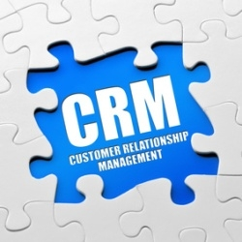
Key Takeaways from Experience
Simplicity is key
Integration with company systems increases effectiveness
If it is not in CRM, it never happened!

Slide 14
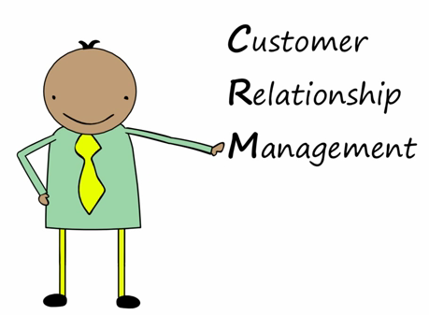
CRM Explained: What it is, what it does, and why you need it
http://www.youtube.com/watch?v=ndP-cfJxOQo

Slide 15
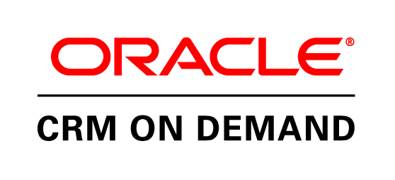
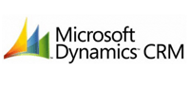
Main CRM Vendors

Slide 16
Any Questions?

Slide 17
Sources
Rouse, Margaret, CRM (Customer Relationship Management), published 22 Nov. 2006 http://searchcrm.techtarget.com/definition/CRM
Ganapathy, S, Ranganathan, C, & Sankaranarayanan, B 2004, 'VISUALIZATION STRATEGIES AND TOOLS FOR ENHANCING CUSTOMER RELATIONSHIP MANAGEMENT', Communications Of The ACM, 47, 11, pp. 93-99, Computers & Applied Sciences Complete, EBSCOhost, viewed 12 October 2013. http://web.ebscohost.com/ehost/pdfviewer/pdfviewer?sid=138ad022-b5e0-40e3-baac-c1892a2cb18e%40sessionmgr198&vid=4&hid=112
Tiwary, D 2010, 'Application of Data Mining in Customer Relationship Management (CRM)', Advances in Computational Sciences & Technology, 3, 4, pp. 527-540, Computers & Applied Sciences Complete, EBSCOhost, viewed 12 October 2013. http://web.ebscohost.com/ehost/pdfviewer/pdfviewer?sid=138ad022-b5e0-40e3-baac-c1892a2cb18e%40sessionmgr198&vid=4&hid=112
Jamalzadeh, M.; Behravan, N.; Markhali, A. Yusefzadeh; Jouya, S. Faramarzi, ‘Customer Relationship Management Constructs Initiating Successful e-business Strategy for Service-based Companies’, Journal of Applied Sciences, 1/1/2013, Vol. 13 Issue 1, p60-69, Computers & Applied Sciences Complete, EBSCOhost, viewed 12 October 2013. http://web.ebscohost.com/ehost/pdfviewer/pdfviewer?vid=3&sid=138ad022-b5e0-40e3-baac-c1892a2cb18e%40sessionmgr198&hid=112
http://www.worketc.com/crm_101/part_2_who_actually_uses_crm/
http://www.benefitsofcrm.com/
http://www.customerservicepoint.com/crm-system.html
“Customer Relationship Management’, Ministry of Economic Development and Trade, viewed 12 October 2013. http://www.nwbiz.ca/wp-content/uploads/customer-relationship-management1.pdf
http://www.cornerstone1.com/index.cfm?meter=588
Bort, Julie, ‘Relating to your Customers’, Colorado Biz, Oct 2000, Vol. 27 Issue 10, p 52. 5 p. 1, EBSCOhost, viewed 12 October 2013. http://ehis.ebscohost.com.nocdbproxy.xavier.edu/eds/detail?sid=c330ed20-d251-491f-9cf4-5b137c4293e0%40sessionmgr110&vid=1&hid=110&bdata=JnNpdGU9ZWRzLWxpdmUmc2NvcGU9c2l0ZQ%3d%3d#db=f5h&AN=3675503

